Slide 1
AutoMS: Automated Optimization of mmWave Coverage using Low-cost MetaSurface
MobiCom 2024
Ruichun Ma ^{1,2}, Shicheng Zheng ^{1,3}, Hao Pan ¹, Lili Qiu ¹, Xingyu Chen ^{1,4}, Liangyu Liu ^{1,5}, Yihong Liu ^{1,5}, Wenjun Hu², Ju Ren⁶
1 Micorosft Research Asia
2 Yale University
3 University of Science and Technology of China
4 University of California San Diego
5 The University of Glasgow
6 Tsinghua University

Slide 2
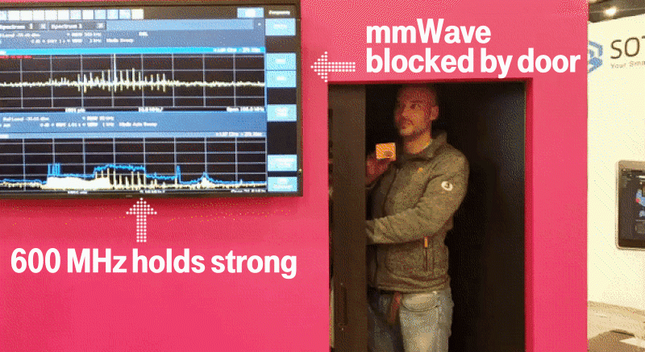
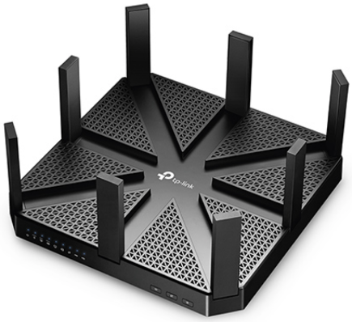
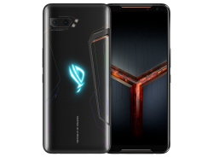
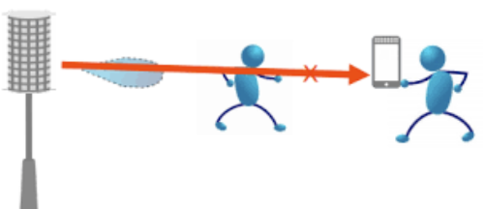
IEEE 802.11ad: mmWave (60GHz) Wi-Fi
Throughput Comparison
Easily blocked by objects such as walls, moving people, and some types of doors
TPLink AD7200: Multi-Band Wi-Fi Router (2.4GHz/5GHz/60GHz )
ROG 2: World's first smartphone to support 802.11ad released in 2019

Slide 3
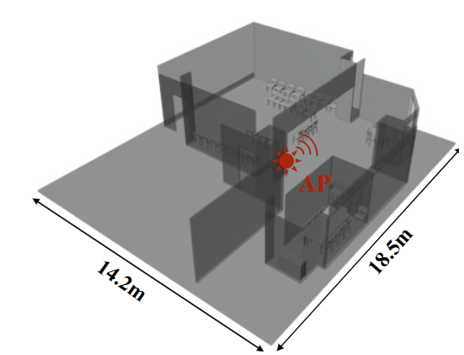
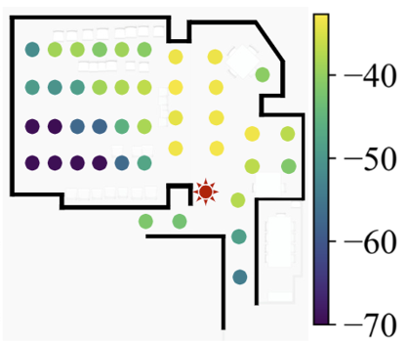
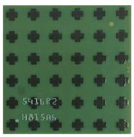
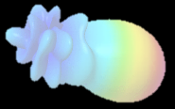
Limited coverage of 60GHz Wi-Fi
Conference room
Measured coverage map
Bad
SNR
In an indoor scenario, mmWave has
almost no diffraction or transmission capability, and its coverage ability is not satisfied.
mmwave AP and its Phased Array antenna

Slide 4
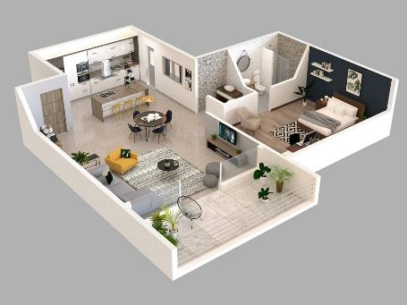
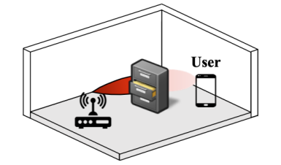
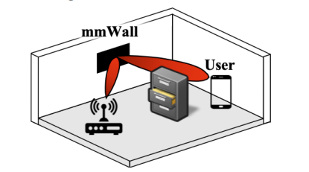
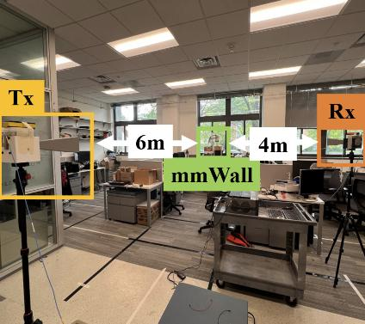
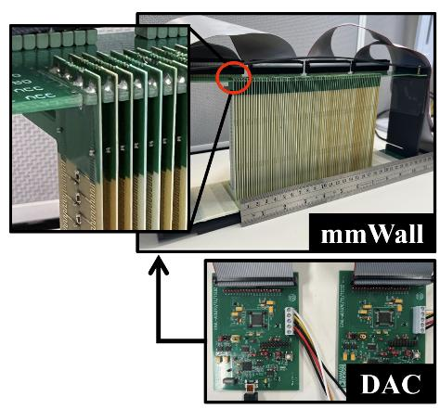
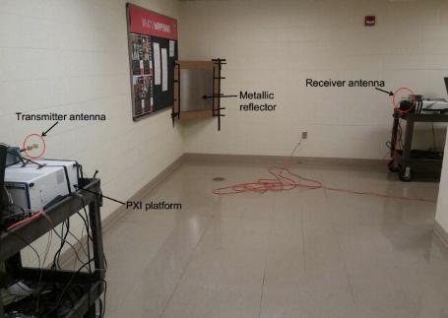
Existing solutions for mmWave coverage enhancement
(1). Multiple APs or Relays
(3). Active Metasurface [2], cost: ~$10000
AP
AP
AP
(2). Metal Reflectors [1]
[1] Coverage enhancement for mm wave communications using passive reflectors. IEEE ComSoc 2020
[2] mmWall: A Steerable, Transflective Metamaterial Surface for NextG mmWave Networks. USENIX NSDI 2023

Slide 5
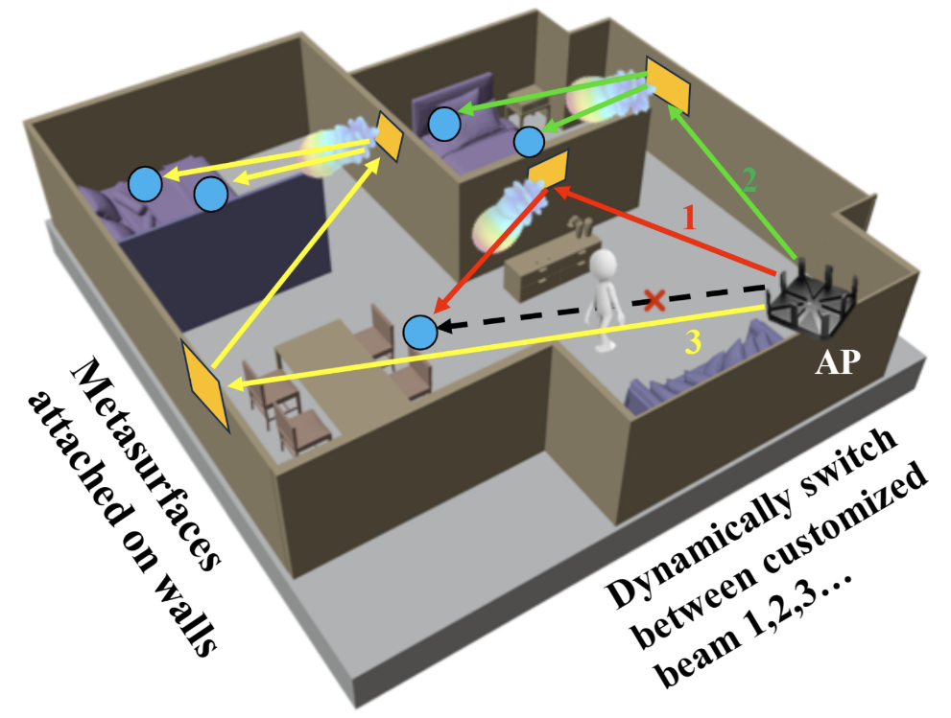
Our idea: How about Low-cost and Passive metasurface?
Deploy metasurface to:
(1) Handle with the Occlusion by movement of human
Path 1
(2) Enhance the coverage
Path 2 and 3
How to determine the optimal passive metasurface?

Slide 6
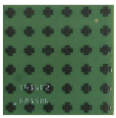
Optimization target: Maximize the coverage of 60GHz Wi-Fi
mts1
Maximize the SUM of channel capacity of all receiver points:
mts2
signal strength
For each RX, select the optimal achievable signal strength from codebook:
Metasurface-affected channel:
Propagation paths affected by the metasurfaces, e.g.,
TX -> mts1 -> … -> mts i -> … -> RX
Direct channel:
Optimal
codeword: $W_{ap}$
Optimal codeword: $W_{ap}$
mts1

Slide 7
Pipeline of our proposed AutoMS

Slide 8
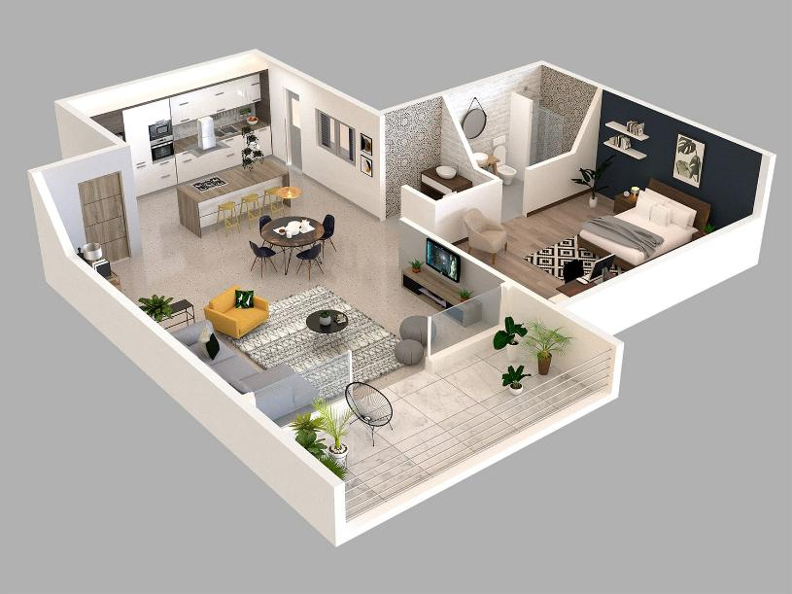
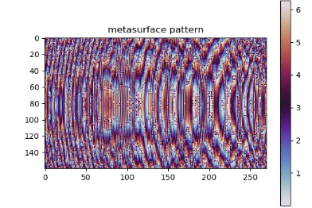
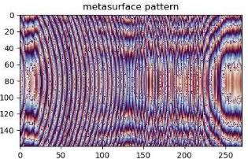
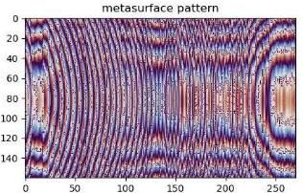
Low-cost fabrication of metasurface
Metasurfaces’ phase maps
MS2
MS3
AP
New CodeBook that cooperates with metasurfaces
MS1
…
Number
Input:
3D model of the env.
Collected RSS samples in the env.
Output:
1. Metasurfaces’ properties
Position
2. Updated AP’s CodeBook
Phase Map

Slide 9
Pipeline of our proposed AutoMS

Slide 10
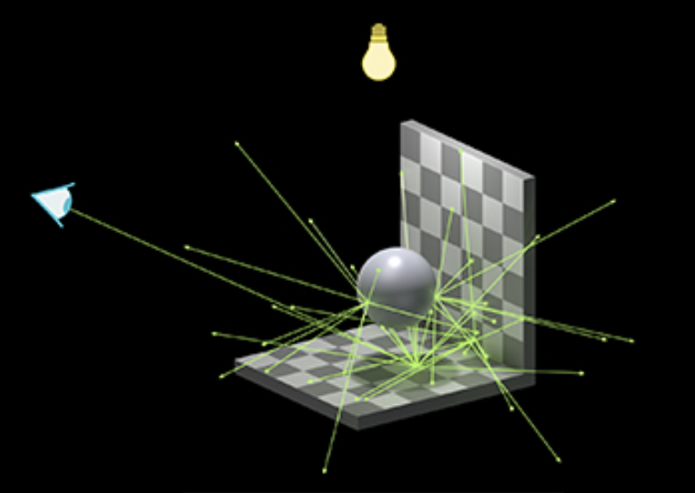
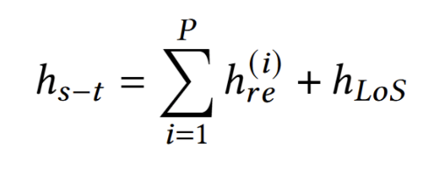
Wireless channel modeling: propagation
3D Ray Tracing
$$r_{k,out}$$
Receiver point
$$r_{k,inc}$$
Source
We build our mmWave channel modeling framework based on the NVIDIA OptiX™ Ray Tracing Engine.
Support metasurface modelling
Support material feature estimation
Optimize propagation path discovery
One of Propagation paths satisfies Near-field:
All propagation paths satisfy Far-field:

Slide 11
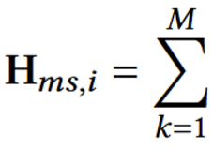
Wireless channel modeling: metasurface
Reflective
metasurface
elements
Reflective
metasurface
elements
$$r_{k, out}$$
$$θ_{k,out}$$
Receiver point
$$θ_{k,inc}$$
Radiation rays
$$r_{k,inc}$$
…
Incident
source
Transmitter
We model the metasurface element as a new micro antenna
Each element can generate new rays when ray reaching it

Slide 12
Propagation path finding and sharing
Path Finding
Mirror point: $$p_{1}^{′}=Ap_{1}$$
Path Sharing
Mirror
point 2
$A$ is the transforming
matrix for calculating
mirror point
Sharing $A$
Object
mesh
Object
mesh
Receiver
point 1
$$θ_{out}$$
$${θ′}_{out}$$
$$θ_{inc}$$
Receiver point: $$p_{1}$$
$${θ′}_{inc}$$
Receiver
point 2
Advantage:
Each receiver point can find path to transmitter, avoid sparse channel estimation
Advantages:
Multiple TX-RX pairs in proximity can share the similar path, conserving memory and computation
Generate transmitted rays
Transmitter
Transmitter

Slide 13
Pipeline of our proposed AutoMS

Slide 14
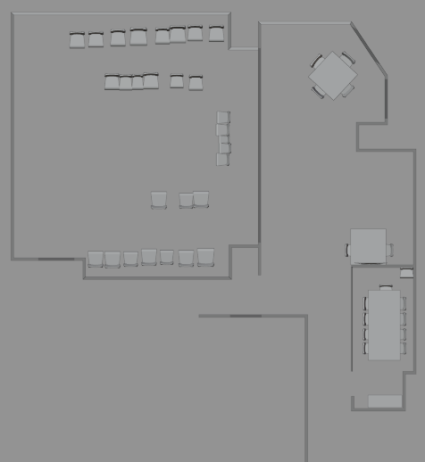
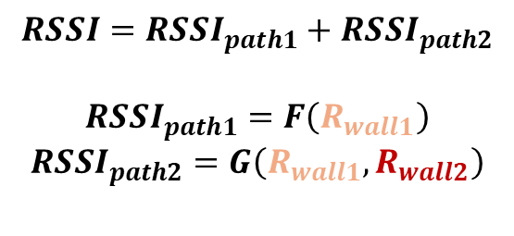
Material Estimation of Material’s Reflection Rate
$$RSSI=RSSI_{path1}+RSSI_{path2}$$
$$RSSI_{path1}=F\left(R_{wall1}\right)$$
$$RSSI_{path2}=G\left(R_{wall1},R_{wall2}\right)$$
wall1
path1
wall2
path2
$$RSSI_{rx1}=F_{rx1}\left(R_{wall1}\right)+G_{rx1}\left(R_{wall1},R_{wall2}\right)$$
$$RSSI_{rx2}=F_{rx2}\left(R_{wall1},R_{wall2}\right)+G_{rx2}\left(R_{wall1},R_{wall3}\right)$$
$$RSSI_{rx3}=…$$
$$RSSI_{rx4}=…$$
…
Obtain the reflection rates of the whole materials in the environment
$$R_{wall1}$$
$$R_{wall2}$$
$$R_{wall3}$$
$$R_{TV}$$
…

Slide 15
Pipeline of our proposed AutoMS

Slide 16
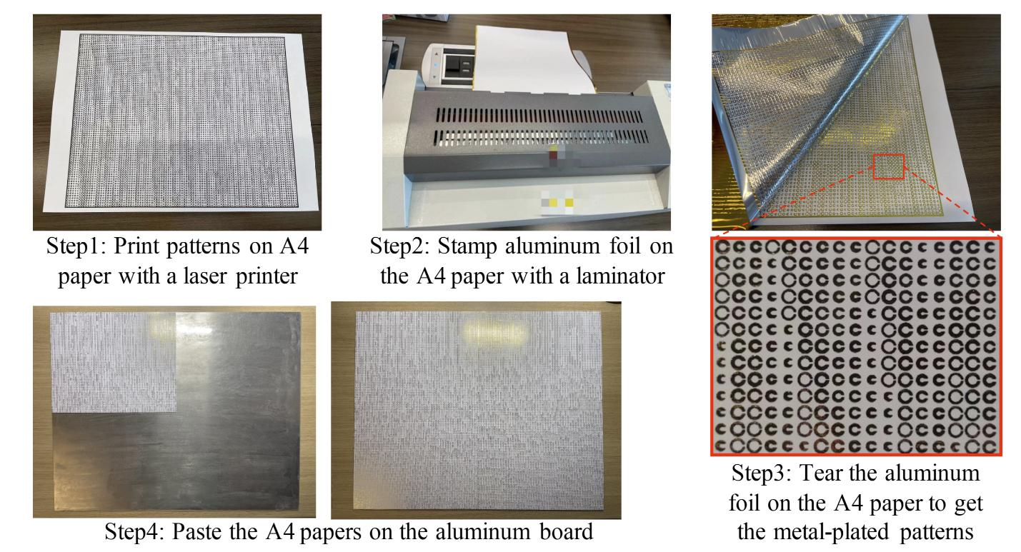
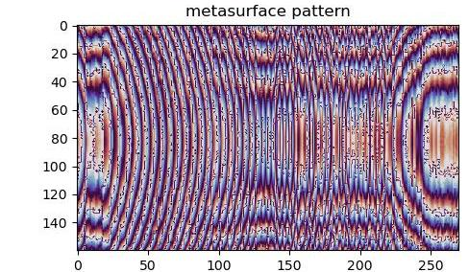
Low-cost fabrication of metasurface
Optimized Metasurface Phase Map Profile

Slide 17
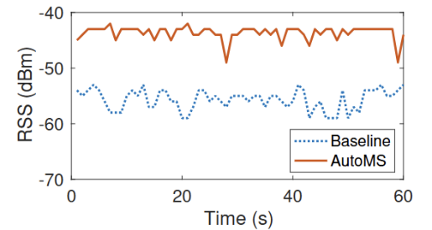
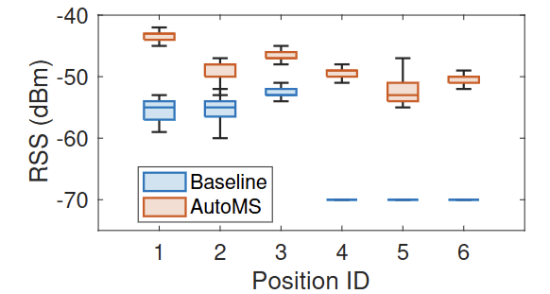
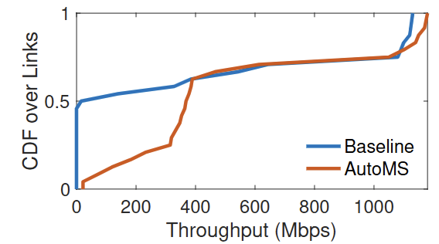
Real-world experiment results
~13dB
77.2 Mbps
~21dB
373 Mbps
RSS measurements in the room when people walk around
RSS measurements in the room when people walk around
Measured throughput

Slide 18
Real-world experiment results

Slide 19
Thanks for listening!

